Slide 2
St Michael & All Angels Netball Club
2017 Sponsorship Information

Slide 3
SMAA Netball Club Important Information
Location: 2 Retallack Ave, Marleston SA 5033
Website: www.smaanetballclub.com.au
Position | Contact | Email: | Phone:
President | Bronwyn Thain | president@smaanetballclub.com.au | 0414 253 654
Sponsorship Co-ordinator | Jess Evans | mmtevans@gmail.com | 0418 929 698
Treasurer | Sharon Stephenson | treasurer@smaanetballclub.com.au | 0405 474 686
Admin Officer | Tania Costello | admin@smaanetballclub.com.au | 0403 821 598

Slide 4
History
We are St Michael and All Angels Netball Club (SMAA) our membership is currently 291 junior and senior players, making us the largest player participated club in the western suburbs.
In 1993 the club commenced with 4 teams (approx. 40 girls) and we played on the courts near the Henley Sharks Football Club.
The club began to grow rapidly in the late 1990’s seeing a move in 2000 to Cudmore Terrace, Henley Beach, where we stayed for 12 years. In 2012 we moved to Nazareth Catholic College, Underdale which was our home base for a further 4 years.
This year 2017 has seen our club move to a new, more permanent, home base at the Marleston Sports Centre, where we have signed a 10 year lease. These premises give us access to 7 courts and clubrooms . Our club has continued to grow significantly over the years and continues to be a popular club with players from other clubs registering with us in an effort to attain the skills and “sportsmanship” qualities that St Michael’s has become known for.
Our club is associated with SAUCNA (South Australian United Church Netball Association) and our players make up at least 32 teams during both the winter season and summer seasons.
Our current membership numbers are approximately 220 junior players and 70 senior players. When we include our parents of players, coaches and umpires, our weekly presence at games is in excess of 1000 people and we are supported by local business and the local community making our club a true community club!

Slide 5
Player numbers & Residential distribution (December 2016)
Age Group | No of Players
U8 | 39
U9 | 37
U11 | 45
U13 | 56
U15 | 35
U17 | 17
Seniors | 72
TOTAL | 291
Suburb | No of Players
Henley Beach | 42
West Beach | 26
Lockleys | 19
Grange | 11
Allenby Gardens | 10
Seaton | 10
Other (covers 80 Western suburbs) | 173
TOTAL | 291

Slide 6
Platinum Package - $2500
Facebook advertising – monthly
Access to player database for promotion twice p/a
Advertising in newsletters – ¼ page
Signage at home courts/ front gate - 2400x1200
Website recognition – logo, blurb and website link
Recognition at SMAA events
Club photo to display
Logo displayed on training tops for the season including coaches jackets

Slide 7
Gold Package - $1500
Sponsorship for 1 x Team training tops
Facebook advertising – four per year
Website recognition – logo, blurb and website link
Access to player database for promotion once p/a
Signage at home courts – 2400x1200
Recognition at SMAA events
Club photo to display

Slide 8
Silver Package - $1000
Sponsorship for 1 x Team training tops
Signage at home courts – 1200 x 1200 / or sandwich board style option
Logo on website
Team picture to display

Slide 9
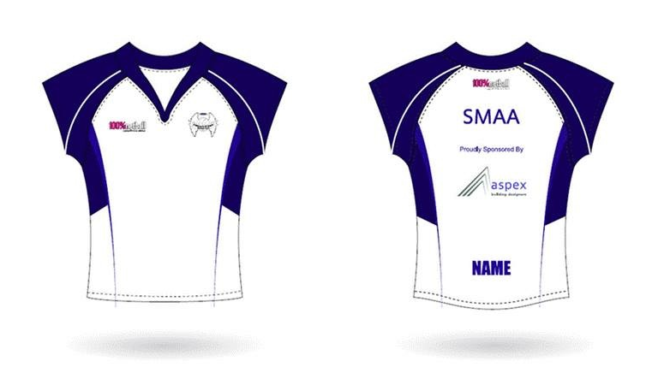
Logo Positioning Club Sponsorship - Example
Your company logo here

Slide 10
Club Sponsorship Agreement
Sponsors Name:
Contact Name:
Address:
Phone:
Email:
Website:
Sponsorship Level: (please circle) | Platinum, Gold, Silver
Term of contract: (please circle) | 1 calendar year, 2 calendar years, 3 calendar years
Payment Arrangement:(please circle) | EFT, Cash, Credit Card
Contract Special Conditions:
Date of Agreement:
Sponsors Signature:
SMAA Signature:
 | Sponsor to email admin@smaanetballclub.com.au company logo, promotional photos, & short text paragraph to be used for advertising.

